Slide 1


“Black-box Tests for Algorithmic Stability” Regression & Coverage Stability Implemented on IVIM
M.Sc. Students
Kfir Levi
Priel Salomon

Slide 2
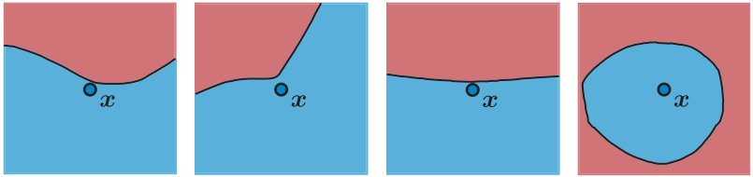
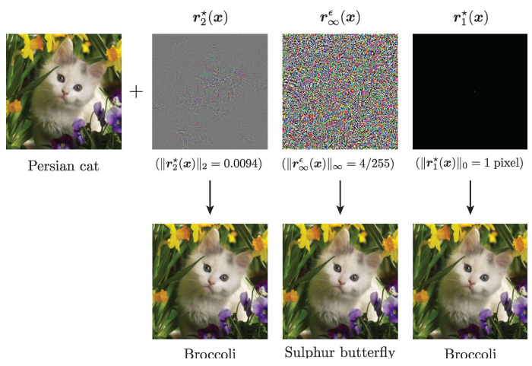
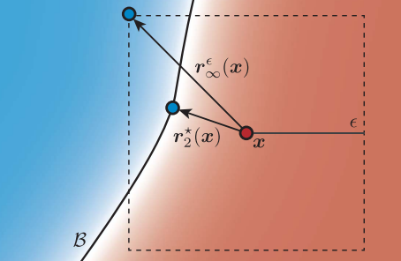
DNNs Robustness
Incredible accuracy but classifier fooled easily.
Changes to the input data affects the output.
Based on [3]
Notes:
Algorithmic stability is a concept from learning theory that expresses the degree to which changes to the input data (e.g., removal of a single data point) may affect the outputs of a regression algorithm. Knowing an algorithm’s stability properties is often useful for many downstream applications—for example, stability is known to lead to desirable generalization properties and predictive inference guarantees.

Slide 3
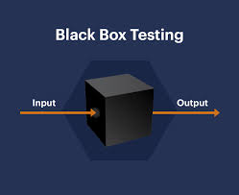
Paper Abstract
Many modern algorithms currently used in practice are too complex for a theoretical analysis of their stability properties, and thus we can only attempt to establish these properties through an empirical exploration of the algorithm’s behavior on various datasets.
A formal statistical framework of black-box testing without any assumptions on the:
algorithm properties
data distribution
Based on [1]
Notes:
להתמקד יותר במשמעות המבחן הנוכחי כקופסא שחורה ללא התייחסות למאפייני המודל

Slide 4

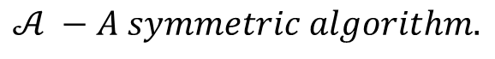
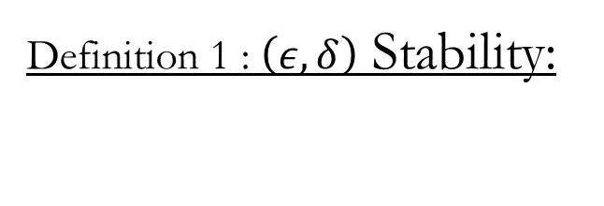
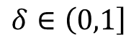
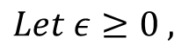
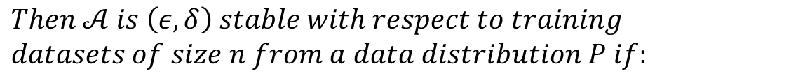
Definition 1 : $\left(ε,δ\right)$ Stability:
Goal - Establish that slight perturbations to the training dataset are not likely to substantially affect the resulting fitted function
$𝒜 −A symmetric algorithm.$
$${\hat{μ}}_{n}= 𝒜\left[\left(x_{1},y_{1}\right),…,\left(x_{n},y_{n}\right)\right];ξ], ξ\sim Uniform[0,1]$$
$$Let ε≥0 ,$$
$$δ∈\left(0,1\right]$$
$$Then 𝒜 is \left(ε,δ\right) stable with respect to training$$
$$datasets of size n from a data distribution P if:$$
$$ℙ\left\{\left|{\hat{μ}}_{n}\left(x_{n+1}\right)−{\hat{μ}}_{n−1}\left(x_{n+1}\right)\right|>ε\right\}≤δ$$
Based on [1]

Slide 5
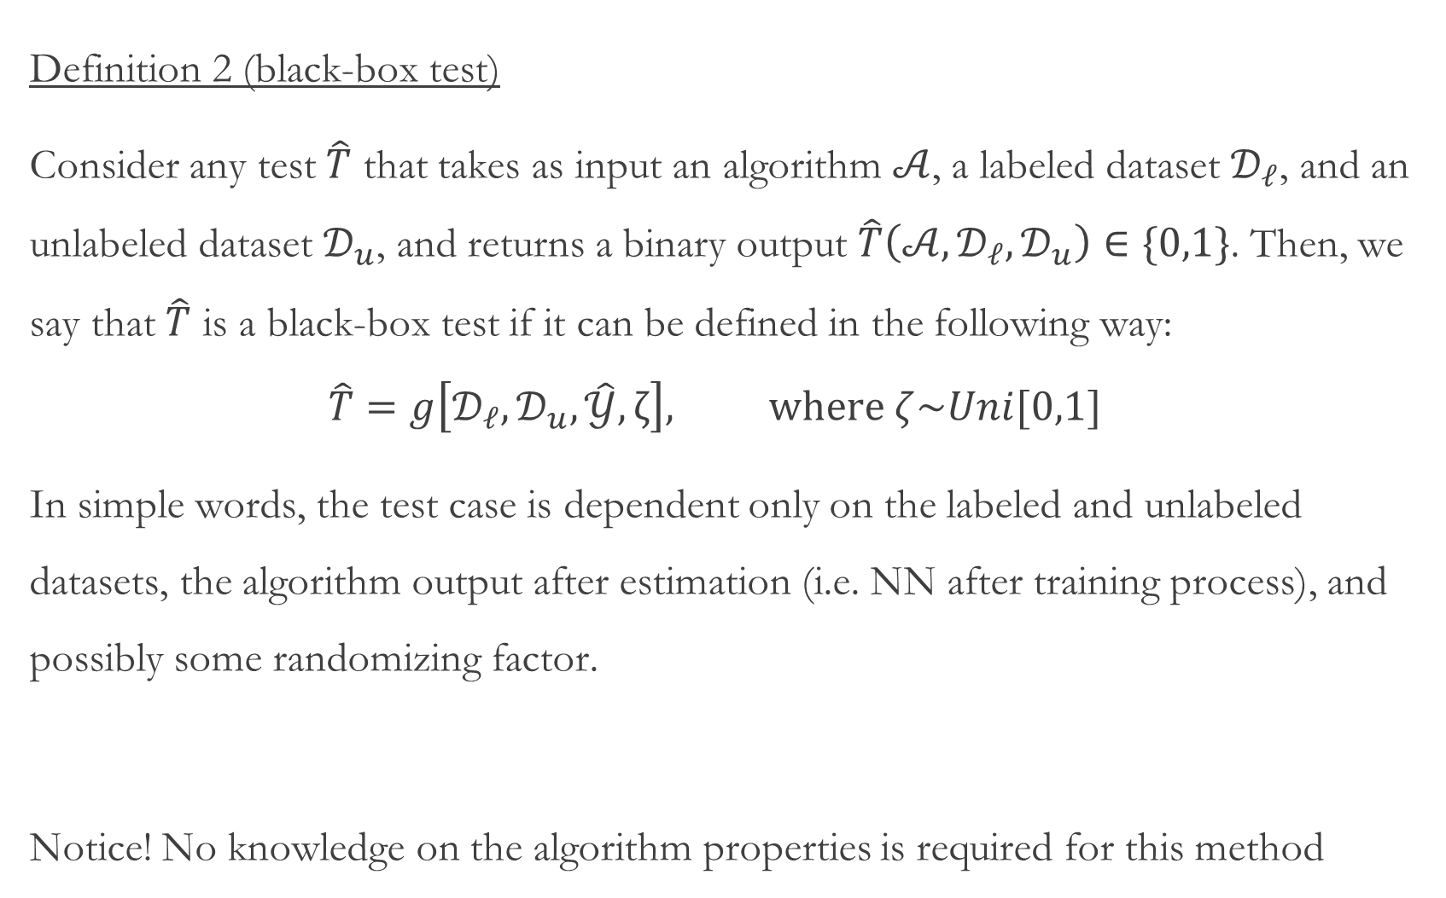
Definition 2 (black-box test)
Consider any test $\hat{T}$ that takes as input an algorithm $𝒜$, a labeled dataset $𝒟_{ℓ}$, and an unlabeled dataset $𝒟_{u}$, and returns a binary output $\hat{T}\left(𝒜,𝒟_{ℓ},𝒟_{u}\right)∈\{0,1\}$. Then, we say that $\hat{T}$ is a black-box test if it can be defined in the following way:
$$\hat{T}=g\left[𝒟_{ℓ},𝒟_{u},\hat{𝒴},ζ\right], where ζ\sim Uni[0,1]$$
In simple words, the test case is dependent only on the labeled and unlabeled datasets, the algorithm output after estimation (i.e. NN after training process), and possibly some randomizing factor.
Notice! No knowledge on the algorithm properties is required for this method
Based on [1]

Slide 6
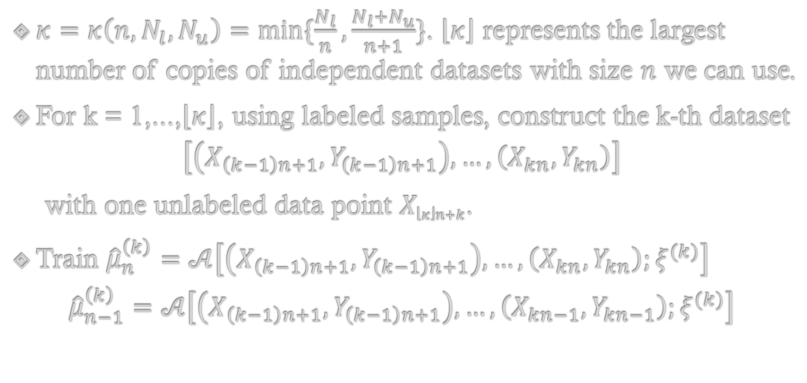
Example
$κ=κ\left(n, N_{l}, N_{u}\right)=\min{\{\frac{N_{l}}{n},\frac{N_{l}+N_{u}}{n+1}\}}$. $\left\lfloor κ\right\rfloor$ represents the largest number of copies of independent datasets with size $n$ we can use.
For k = 1,...,$\left\lfloor κ\right\rfloor$, using labeled samples, construct the k-th dataset
$$\left[\left(X_{\left(k−1\right)n+1},Y_{\left(k−1\right)n+1}\right),…,\left(X_{kn},Y_{kn}\right)\right]$$
with one unlabeled data point $X_{\left\lfloor κ\right\rfloor n+k}$.
Train ${\hat{μ}}_{n}^{\left(k\right)}=𝒜\left[\left(X_{\left(k−1\right)n+1},Y_{\left(k−1\right)n+1}\right),…,\left(X_{kn},Y_{kn}\right);ξ^{(k)}\right]$
$${\hat{μ}}_{n−1}^{\left(k\right)}=𝒜\left[\left(X_{\left(k−1\right)n+1},Y_{\left(k−1\right)n+1}\right),…,\left(X_{kn−1},Y_{kn−1}\right);ξ^{(k)}\right]$$
Based on [1]

Slide 7
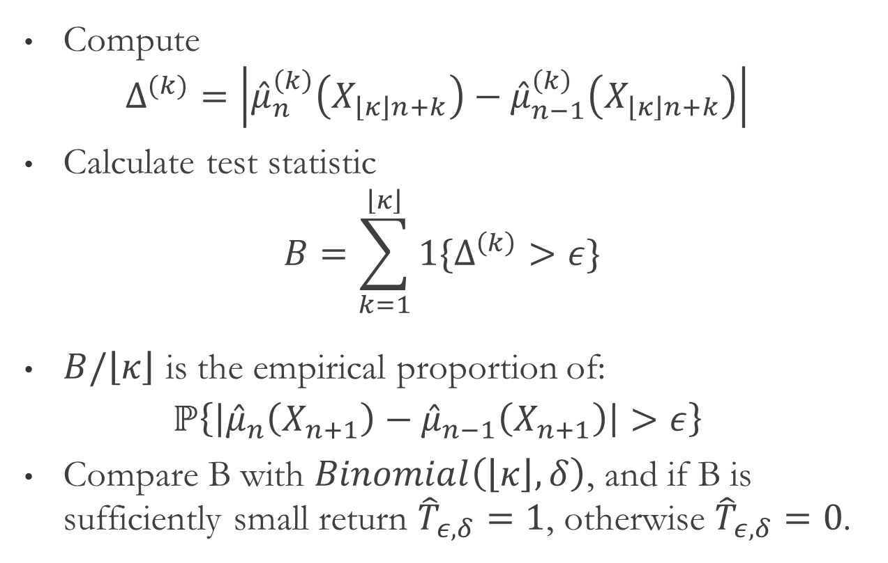
Example – The Binomial Test
Compute
$$Δ^{(k)}=\left|{\hat{μ}}_{n}^{\left(k\right)}\left(X_{\left\lfloor κ\right\rfloor n+k}\right)−{\hat{μ}}_{n−1}^{\left(k\right)}\left(X_{\left\lfloor κ\right\rfloor n+k}\right)\right|$$
Calculate test statistic
$$B=\sum_{k=1}^{\left\lfloor κ\right\rfloor }{1\{Δ^{\left(k\right)}>ε\}}$$
$B/\left\lfloor κ\right\rfloor$ is the empirical proportion of:
$$ℙ\left\{\left|{\hat{μ}}_{n}\left(X_{n+1}\right)−{\hat{μ}}_{n−1}\left(X_{n+1}\right)\right|>ε\right\}$$
Compare B with $Binomial\left(\left\lfloor κ\right\rfloor , δ\right)$, and if B is sufficiently small return ${\hat{T}}_{ε,δ}=1$, otherwise ${\hat{T}}_{ε,δ}=0$.
Based on [1]

Slide 8
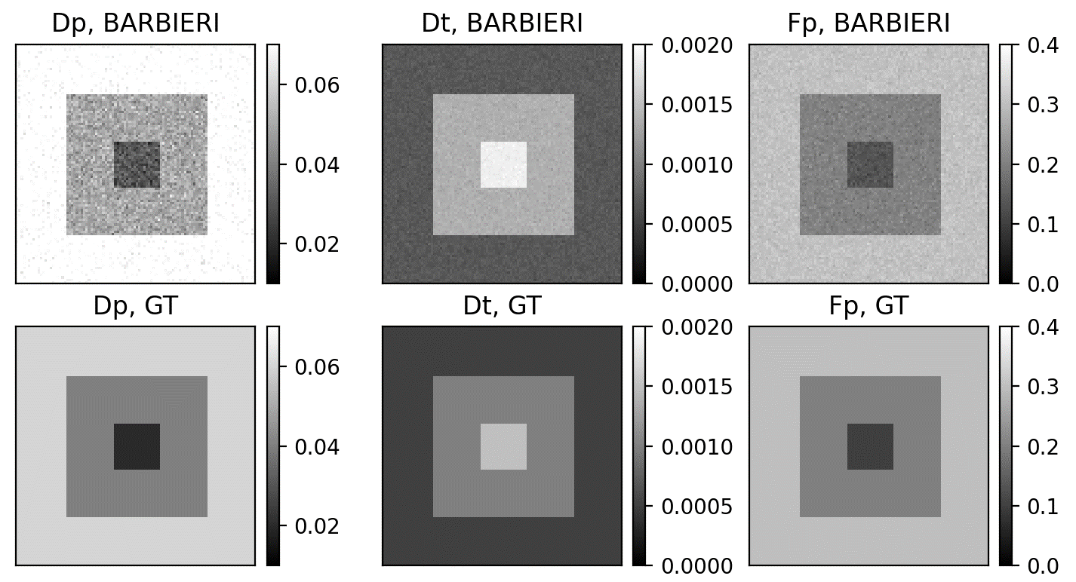
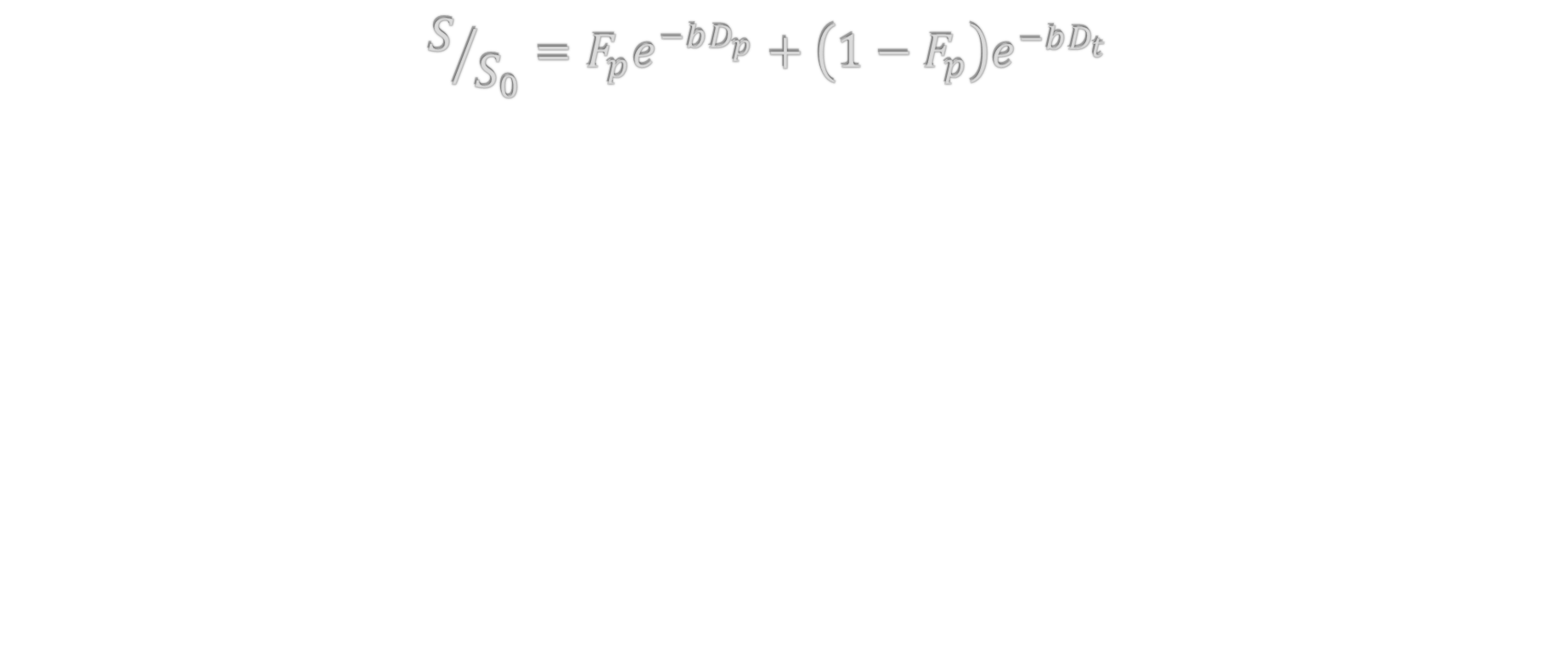
Estimating IntraVoxel Incoherent Motion (IVIM)
$$S/{S_{0}}=F_{p}e^{−bD_{p}}+\left(1−F_{p}\right)e^{−bD_{t}}$$
Based on [2]

Slide 9
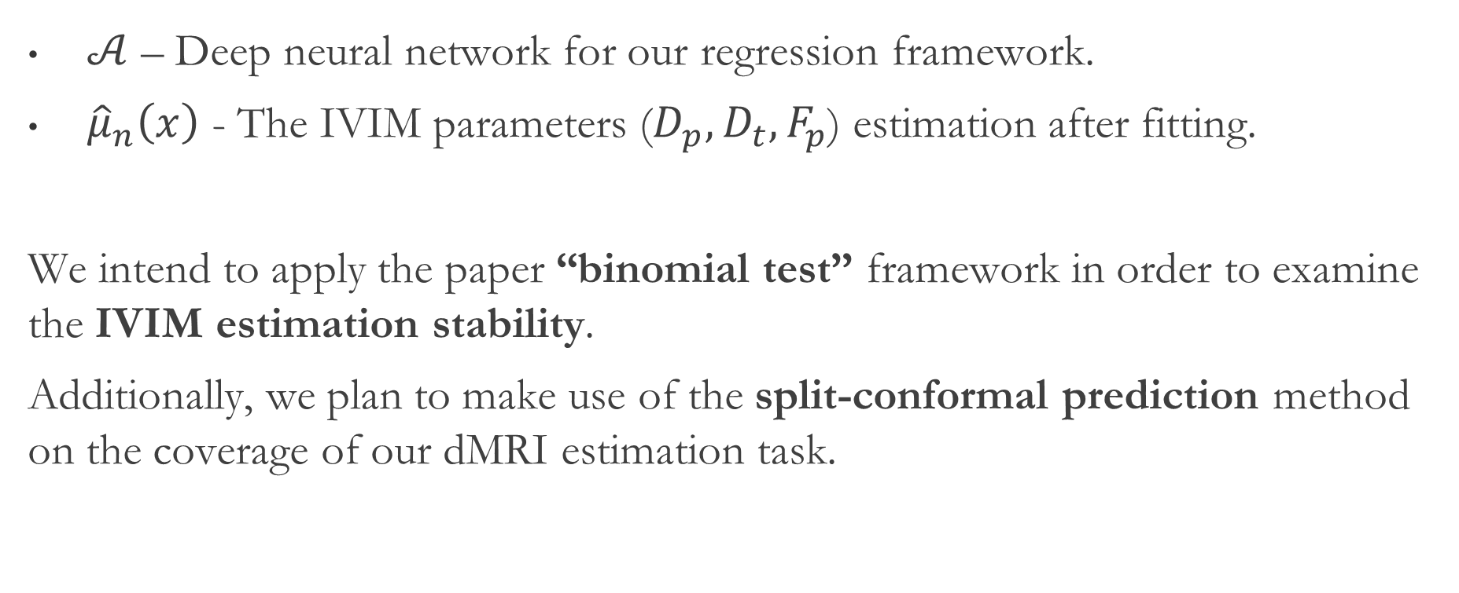
IVIM Estimation Reliability
$𝒜$ – Deep neural network for our regression framework.
${\hat{μ}}_{n}\left(x\right)$ - The IVIM parameters ($D_{p}, D_{t}, F_{p}$) estimation after fitting.
We intend to apply the paper “binomial test” framework in order to examine the IVIM estimation stability.
Additionally, we plan to make use of the split-conformal prediction method on the coverage of our dMRI estimation task.
Based on [2]

Slide 10

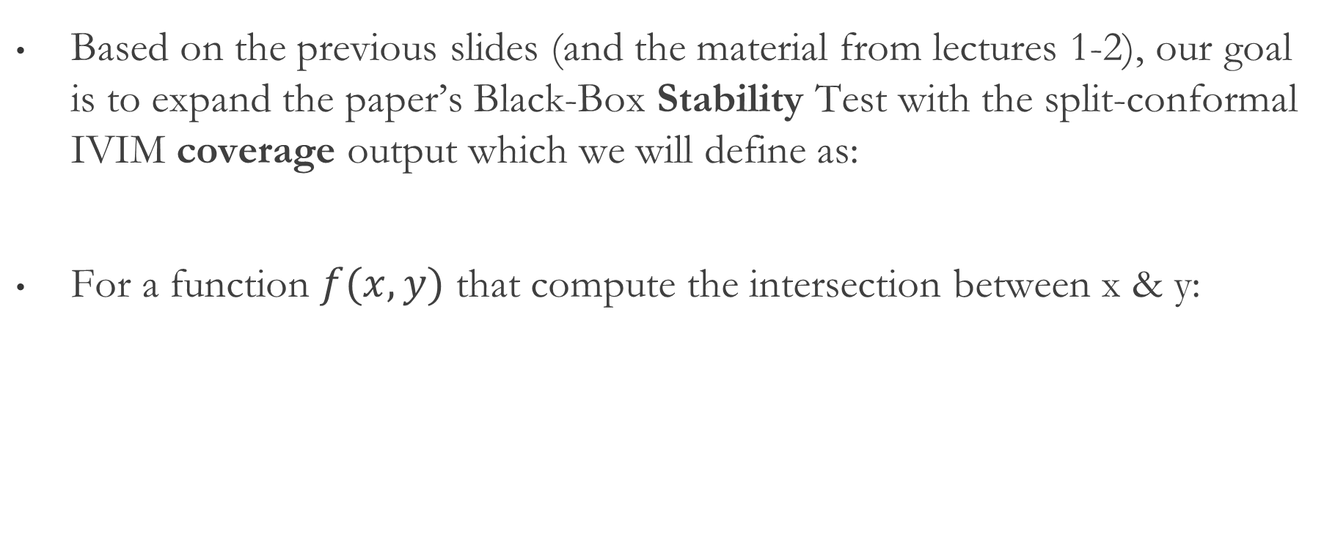

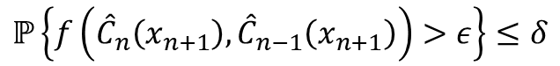
IVIM - Coverage Stability
Based on the previous slides (and the material from lectures 1-2), our goal is to expand the paper’s Black-Box Stability Test with the split-conformal IVIM coverage output which we will define as:
For a function $f(x,y)$ that compute the intersection between x & y:
$$ℙ\left\{f\left({\hat{C}}_{n}\left(x_{n+1}\right),{\hat{C}}_{n−1}\left(x_{n+1}\right)\right)>ε\right\}≤δ$$
$${\hat{C}}_{n}$$
$${\hat{C}}_{n−1}$$
Stability | Coverage | Train
Based on [2]

Slide 11
References
[1] Kim, B., & Barber, R. F. (2021). Black box tests for algorithmic stability. arXiv preprint arXiv:2111.15546.‏
[2] Barbieri, S., Gurney‐Champion, O. J., Klaassen, R., & Thoeny, H. C. (2020). Deep learning how to fit an intravoxel incoherent motion model to diffusion‐weighted MRI. Magnetic resonance in medicine, 83(1), 312-321.‏
[3] Ortiz-Jiménez, G., Modas, A., Moosavi-Dezfooli, S. M., & Frossard, P. (2021). Optimism in the face of adversity: Understanding and improving deep learning through adversarial robustness. Proceedings of the IEEE, 109(5), 635-659.
[4] Shafer, G., & Vovk, V. (2008). A Tutorial on Conformal Prediction. Journal of Machine Learning Research, 9(3).

Slide 12
Thank You For Listening!

